Slide 1
Longest zig-zag subsequence of given sequence
Presented By:
Divyesh Rana - IIT2019063
Akash Deep - IIT2019064
Pedada Gopal - IIT2019065

Slide 2
Problem statement:
Find length of the longest subsequence of given sequence such that all elements of this are alternating.

Slide 3
Explanation
What is zig-zag sequence?
A sequence is called a zig- zag sequence if the differences between successive elements strictly alternate between positive and negative. The first difference (if one exists) may be either positive or negative. A sequence with fewer than two elements is trivially a zig-zag sequence.
If a sequence (x1, x2, . . . , xn) is a zig-zag sequence then its elements satisfy one of the following relation:
(x1 < x2 > x3 < x4 > . . . xn) or (x1 > x2 < x3 > x4 < . . . xn)
The sequence of difference of two successive elements : (+,-,+,- …) Or (-,+,-,+ …)

Slide 4
Algorithmic Design
Array Arr of size n is given as input.
Sign comparison
We know that a sequence is called a zig-zag sequence if the differences between successive elements strictly alternate between positive and negative.
We will proceed by comparing the mathematical signs(negative or positive) of the difference of two consecutive elements of Arr. To achieve this, we will store the sign of (Arr[i] − Arr[i − 1]) in a variable, subsequently comparing it with that of (Arr[i + 1] − Arr[i]).If it is different, we shall increment our result.
In short, we compare the sign of current difference with the sign of the previous difference and if it is different then we increment the result and update the sign for previous difference and return result. Signum(x) function can be used to find sign of a number.

Slide 5

Cont.
Dynamic - programming
We define a two dimensional array dp[n][2].
dp[i][0] - longest zig-zag subsequence ending at index i and last element is greater than its previous element
dp[i][1] - longest zig-zag subsequence ending at index i and last element is smaller than its previous element
Compute ‘dp’ array using following relation,
To find longest length, Keep updating result = max(result, max(dp[i][0], dp[i][1]))

Slide 6
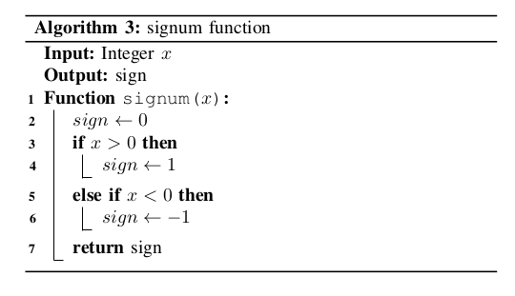
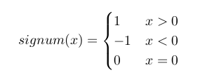
Signum function
A mathematical function used to identify the sign of a number.

Slide 7
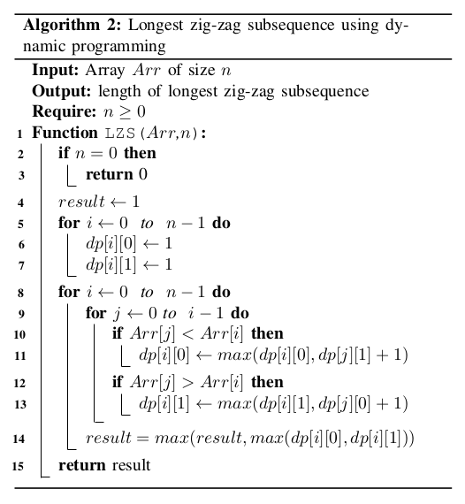
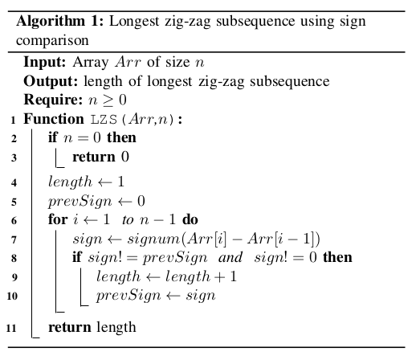
Pseudo Codes

Slide 8
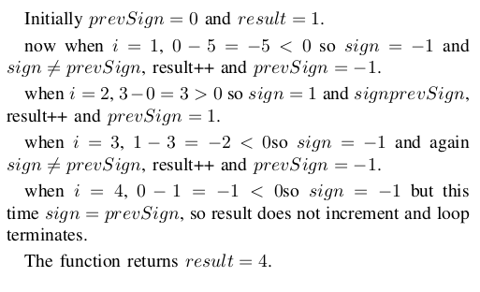
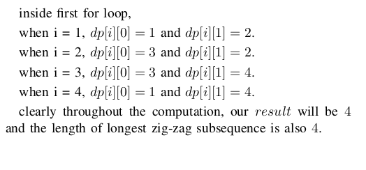
Illustration with example : Arr = {5,0,3,1,0}
First Algorithm (sign comparison)
Second Algorithm (dp)

Slide 9
Algorithm analysis
Time Complexity:
Approach 1: Here, Only single traversal is required to complete the algorithm so the time complexity is O(n). The best case for this algorithm is n = 1, so T _{best} = O(1) and T_{worst}= O(n).
Approach 2: Here, we assume that integer operations take O(1) time. Two loops are used, nested one into other. Therefore, time complexity of this algorithm is O(n²). The best case for this algorithm is n = 1, so T _{best}= O(1) and T_{worst}= O(n²).
Space complexity:
The space complexity for the algorithm is O(n)

Slide 10
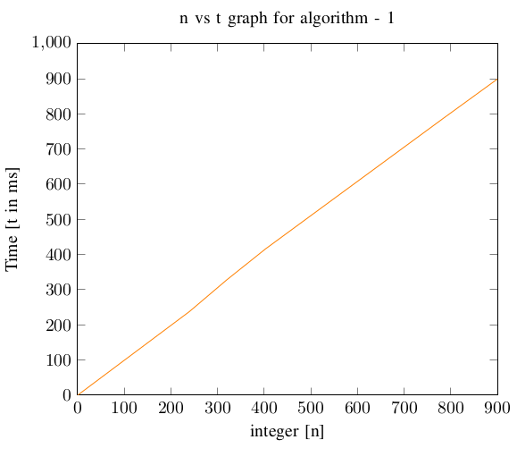
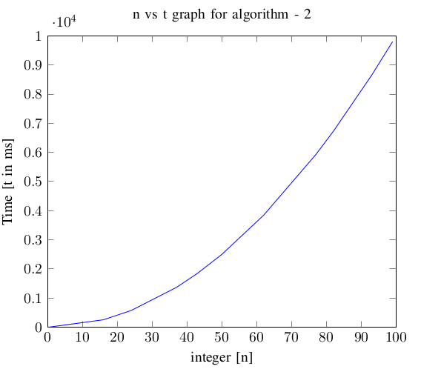
Experimental Analysis
Linear behaviour
n² behaviour

Slide 11
Conclusion
The second algorithm uses the dynamic programming but has the time complexity of O(n²), however first algorithm has time complexity of O(n) which is better than O(n²).

